Slide 1
LINUX COMMANDS
Aleena Joseph
166704

Slide 2
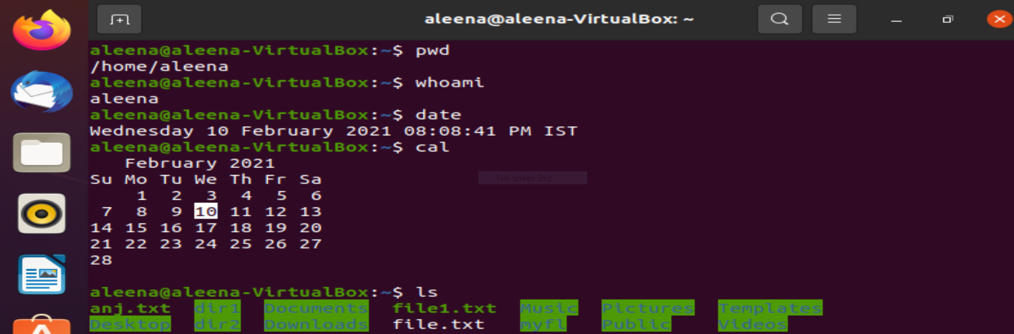
pwd: Shows the present directory.
whoami: Present username.
date: Shows date and current time
cal: Shows calender.

Slide 3
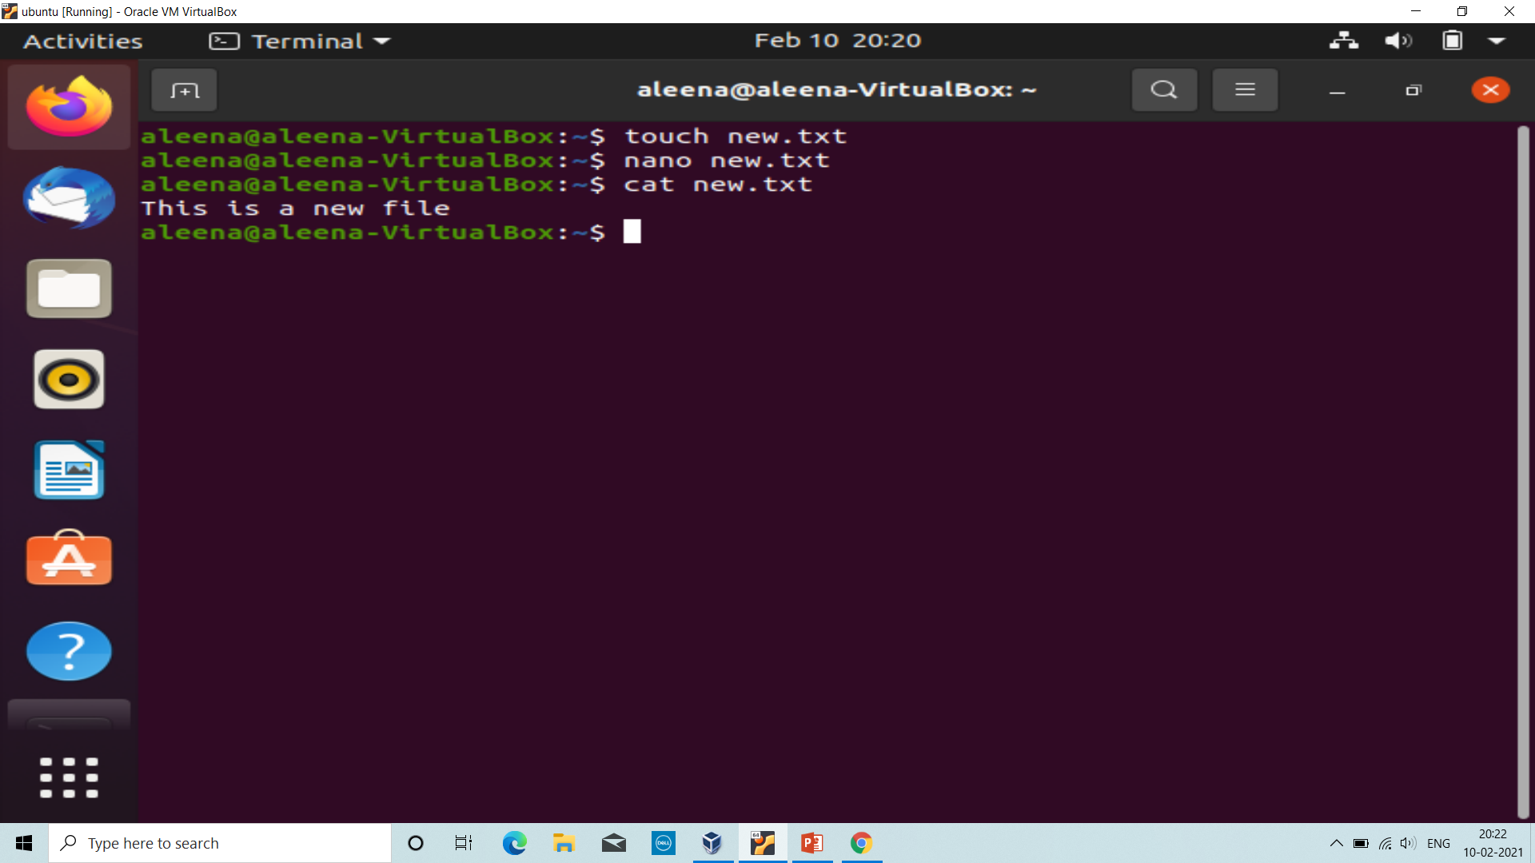
touch: Create a new file
nano: Editor
cat: Places the standard input into the file.

Slide 4
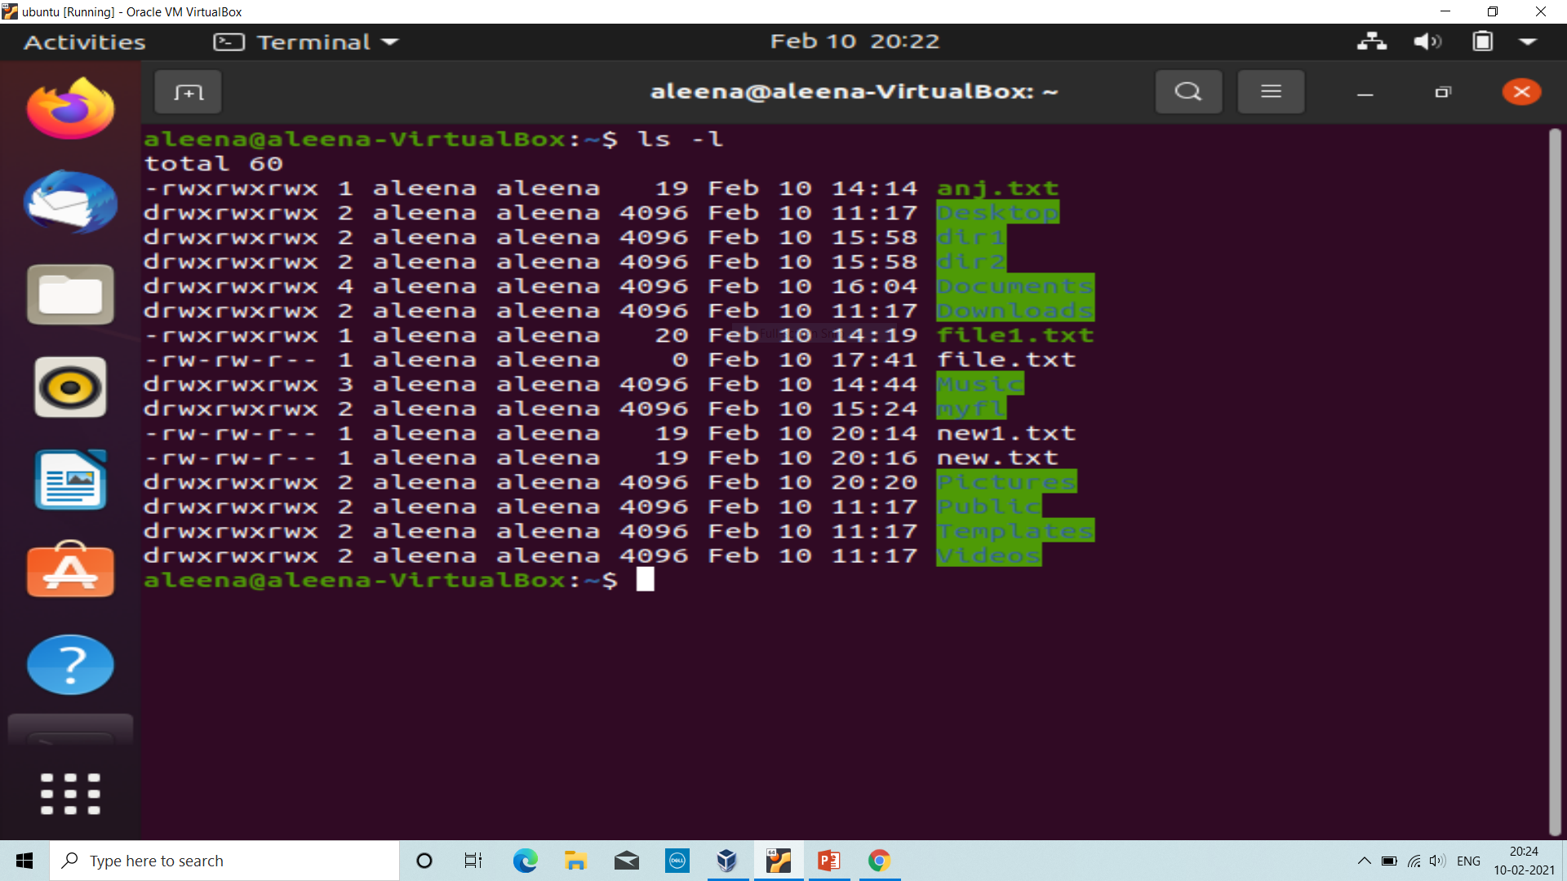
ls –l: Gives complete information of the present directory.
ls –a: List out all hidden files.
ll: Gives complete information of the directory including hidden files.

Slide 5
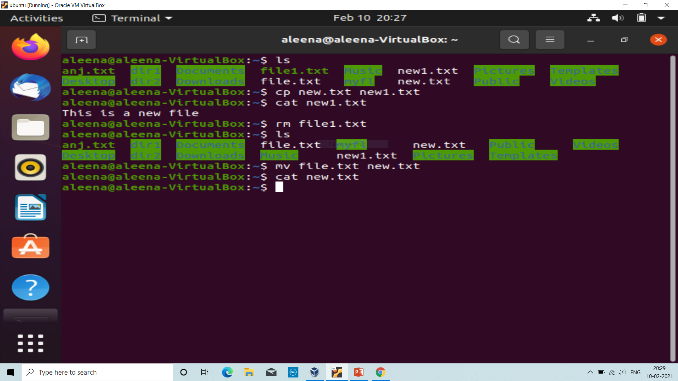
ls: List out the files and folders in the present directory.
cp: Copy a file( cp f1 f2)
rm: Remove a file( rm f1)
mv: Used to move files/ rename/move folders
( mv oldfile newfile)
5. –r dir: remove dir

Slide 6
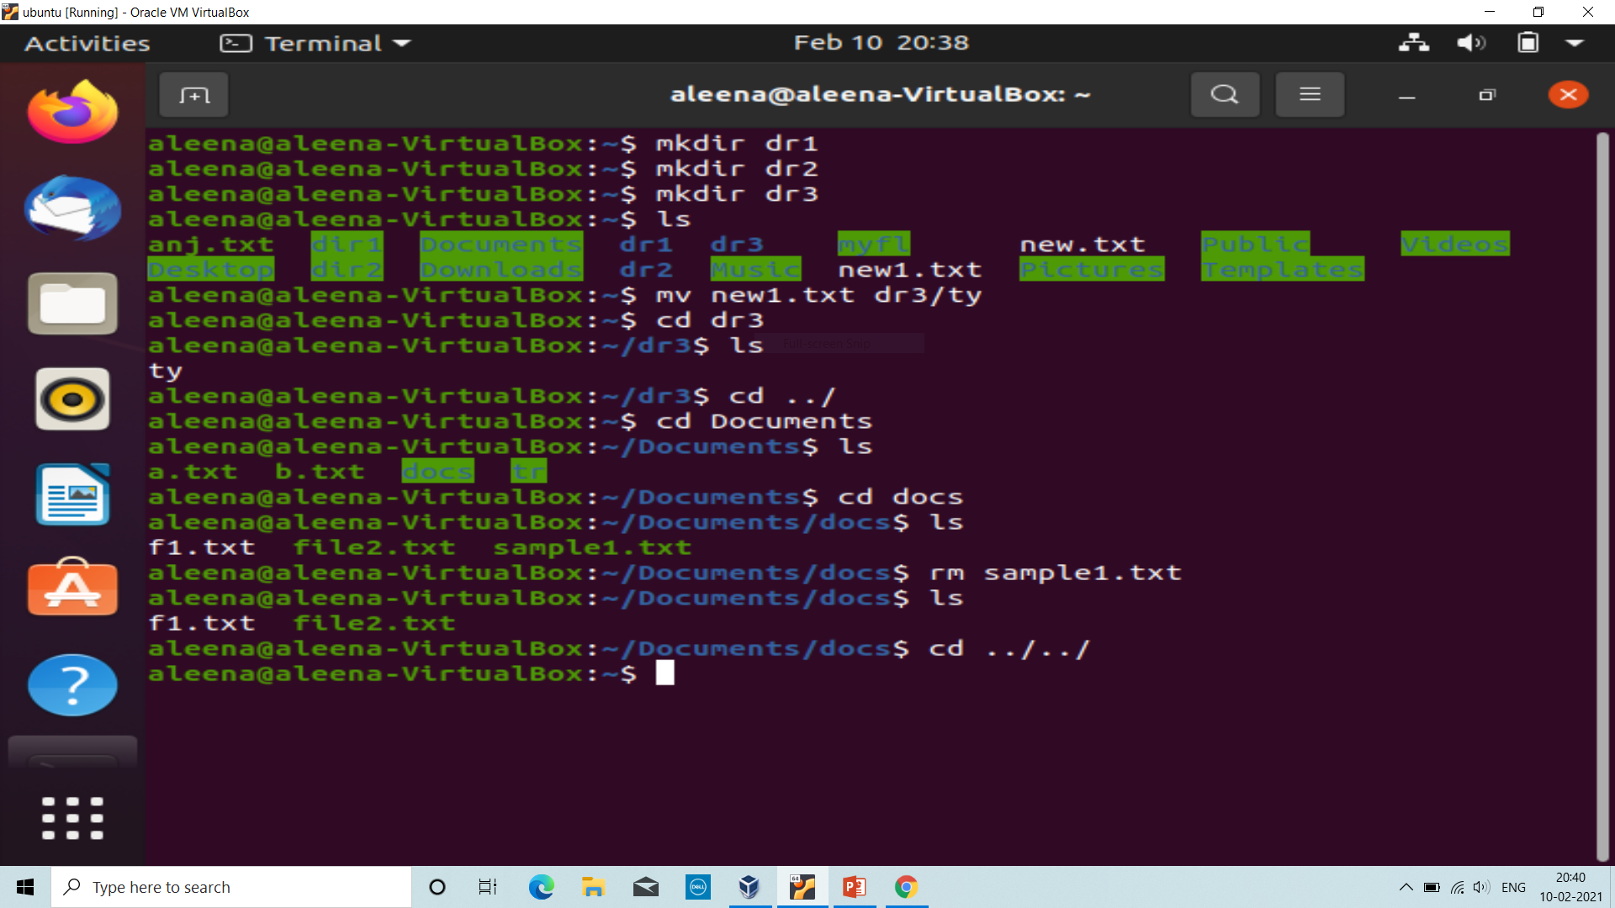
mkdir: Create a directory
cd: Change to home directory
cd dir: Change directory to dir.
cd ../: One level up
cd ../../: Two level up
cd~: Change to home directory.

Slide 7
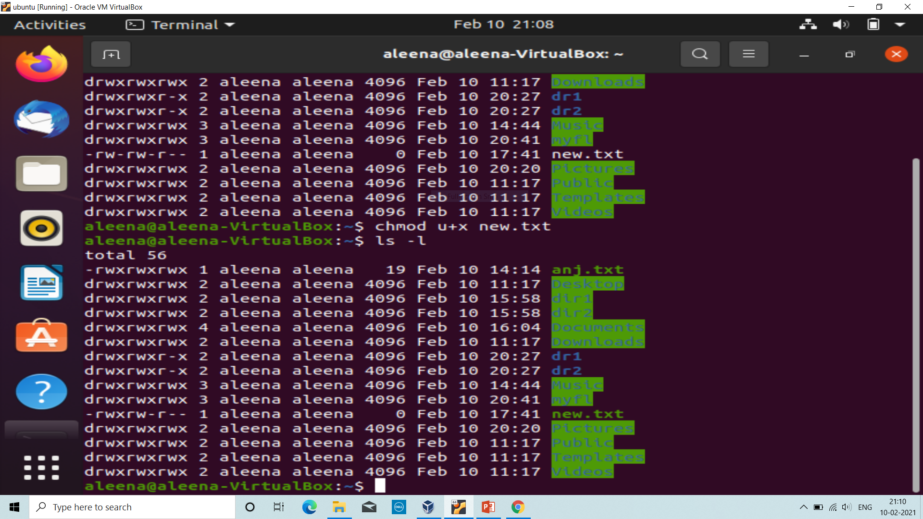
chmod: Allows to change mode of permissions.
chmod +: Adds permission
chmod -: Removes permission
chmod =: Sets the permission
Eg: chmod u+w filename – Adds write permission to ower.

Slide 8
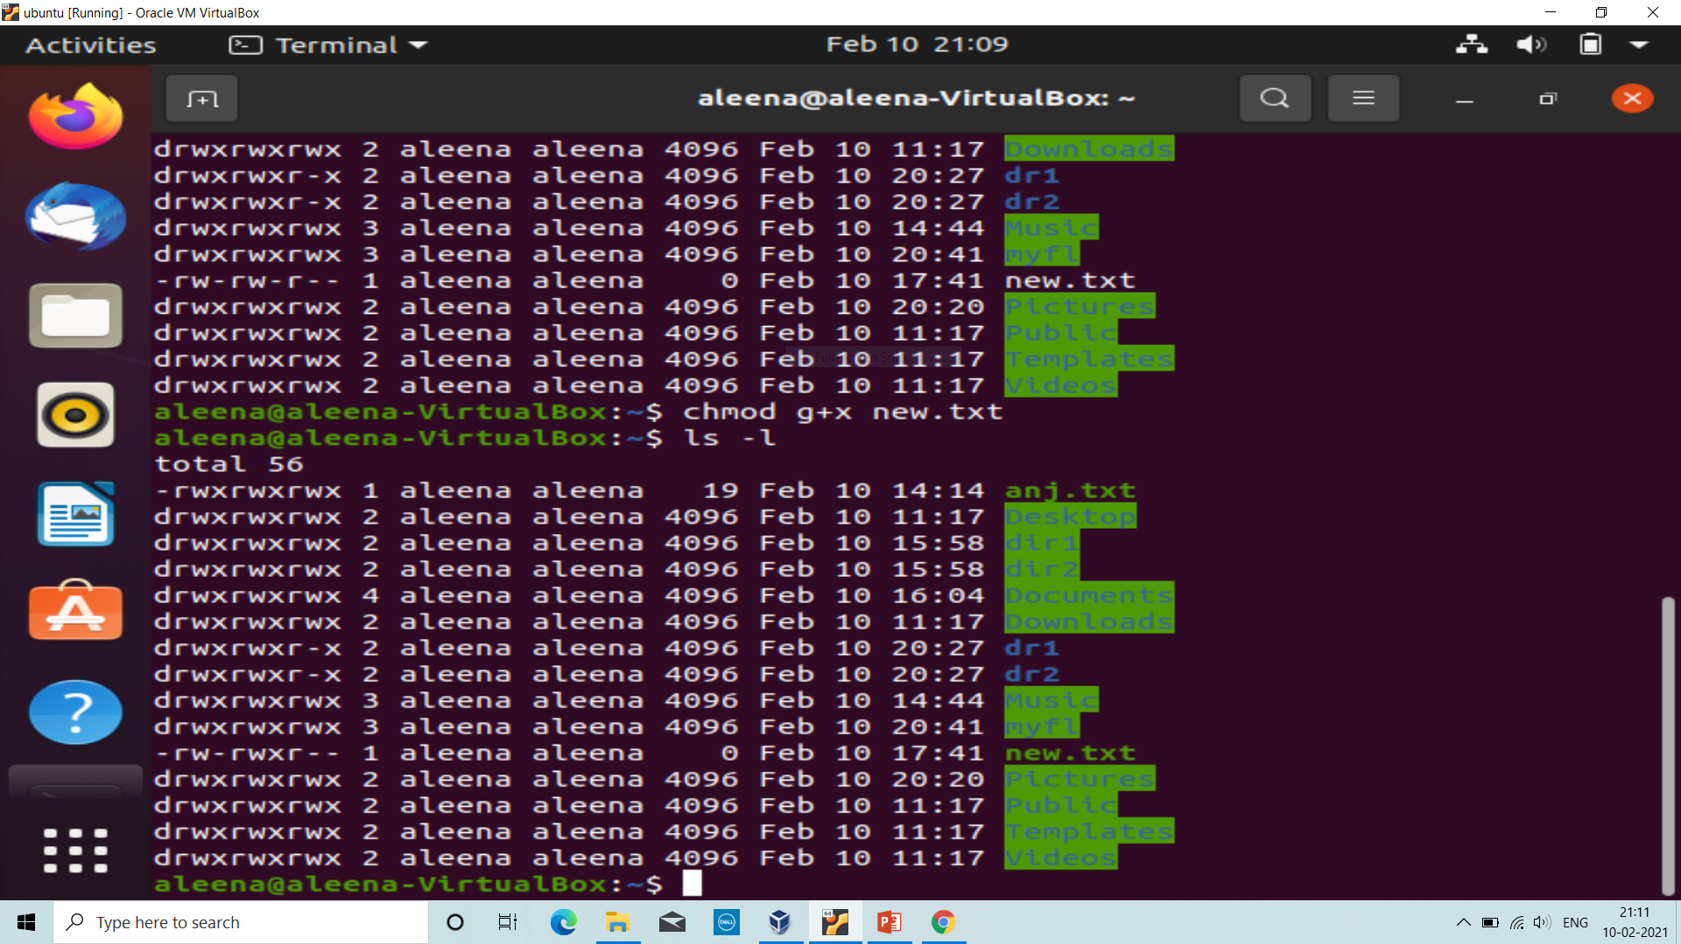
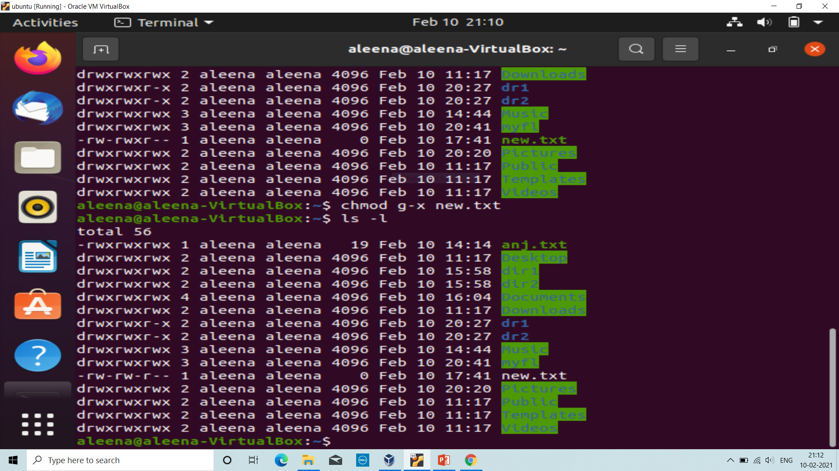

Slide 9
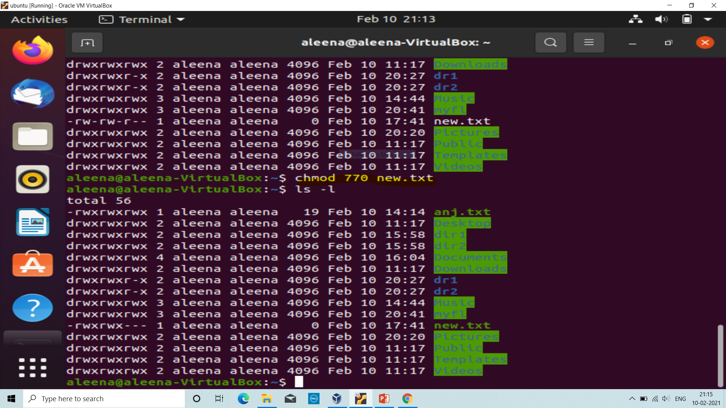
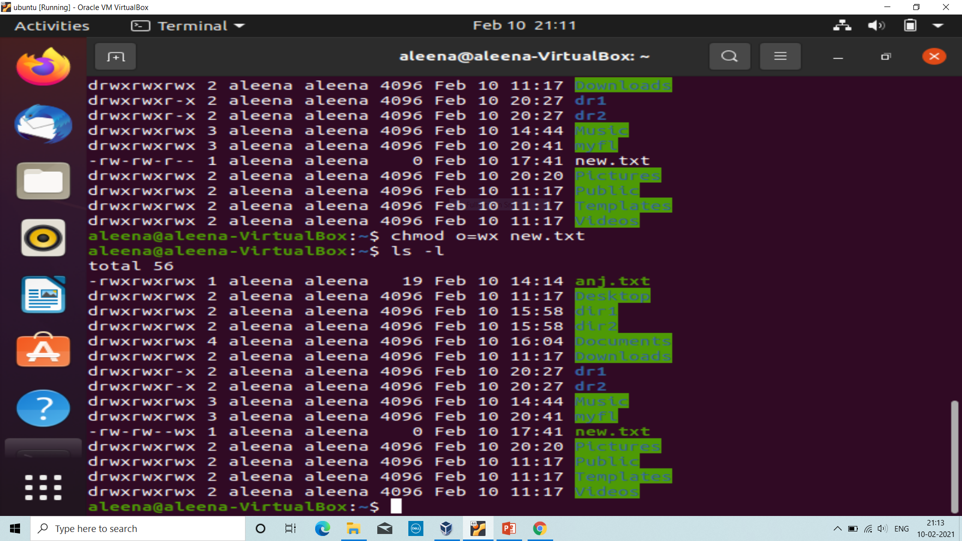
Uses octal numbers instead of operators.

Slide 10
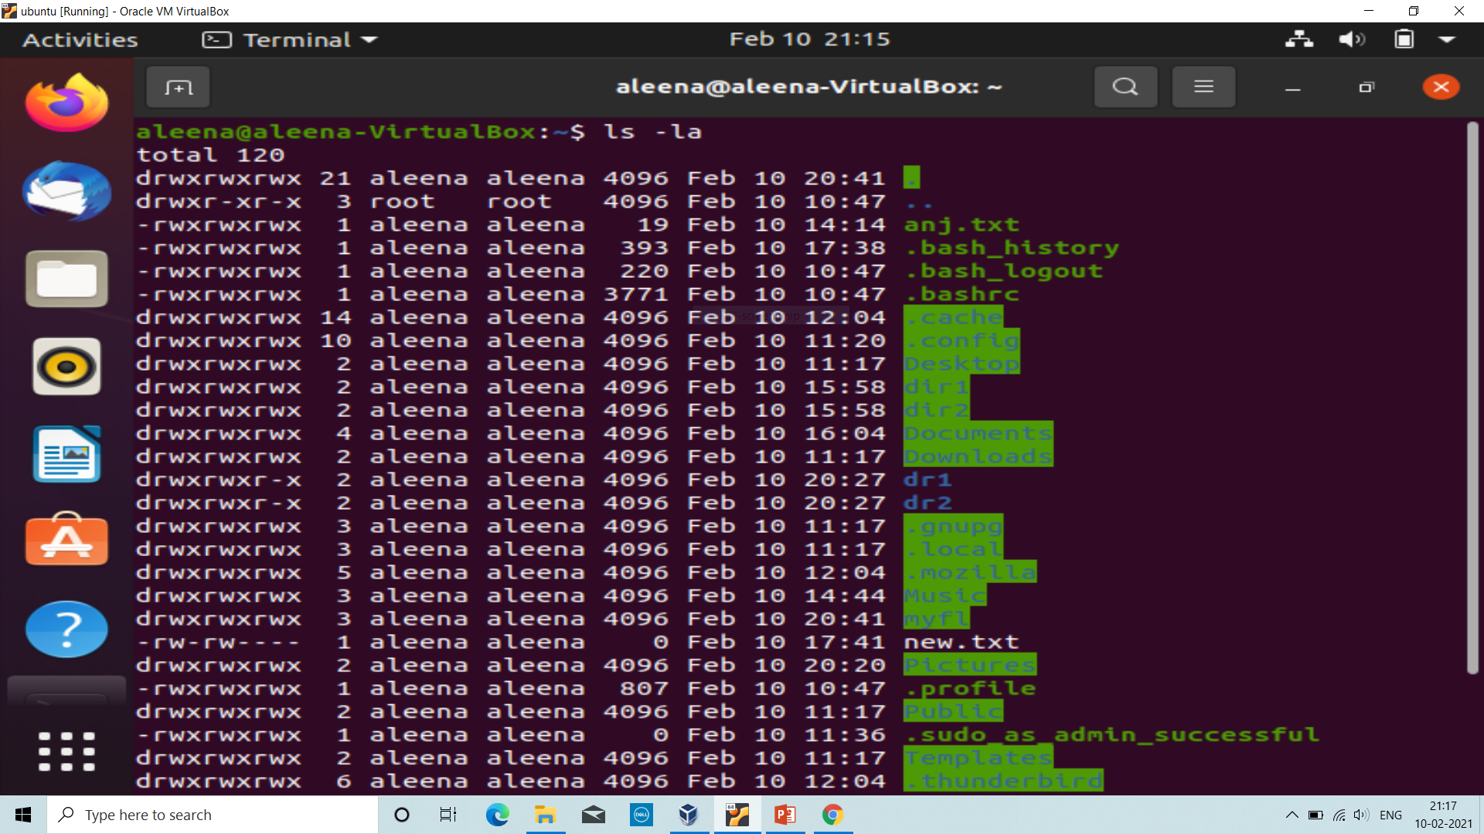
ls –la: List out all hidden files.

Slide 11
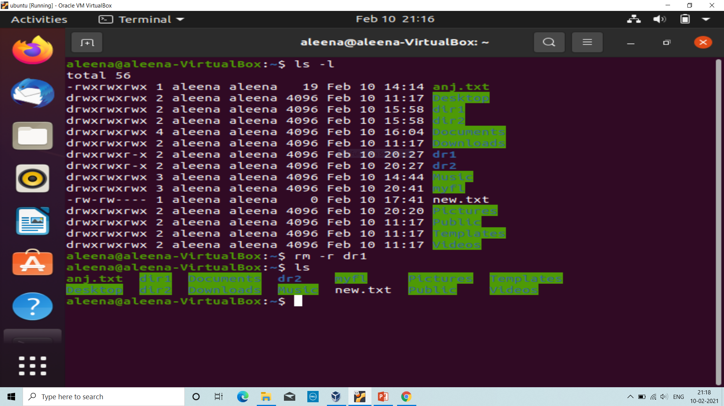
ls –l: Lists out the complete information of the present directory.

Slide 12
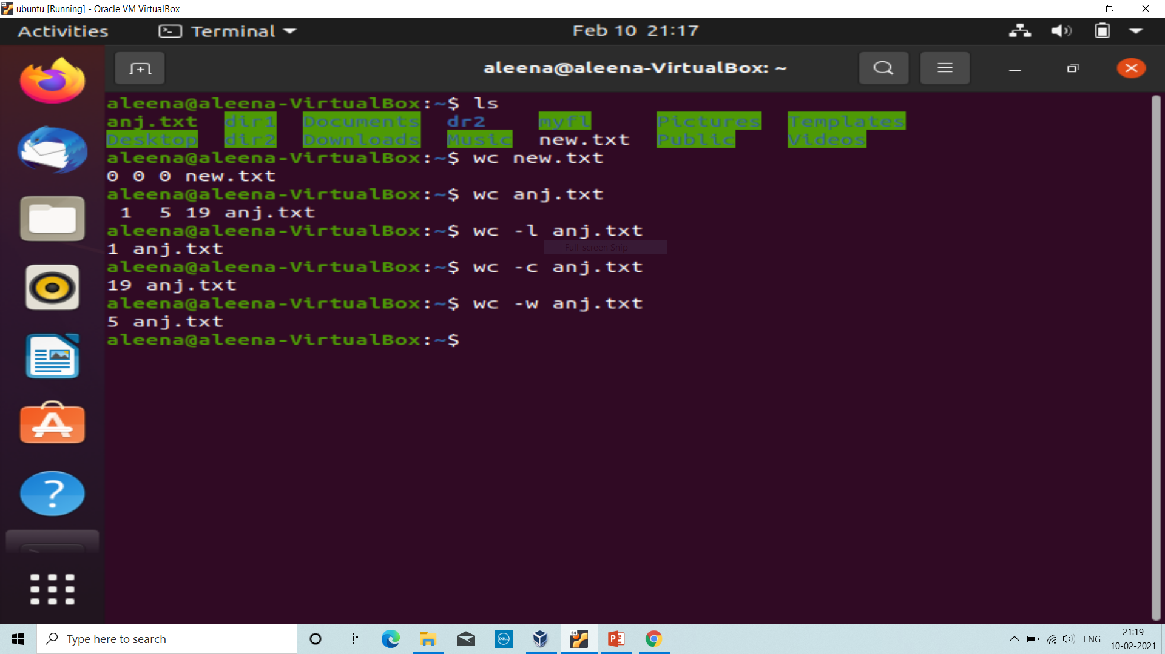
wc : Gives the word, charcter and line count of the file.
wc –l filename: Gives the linecount of the file.
wc –w filename: Gives the word count of the file.
wc –c filename: Gives the character count of the file.

Slide 13
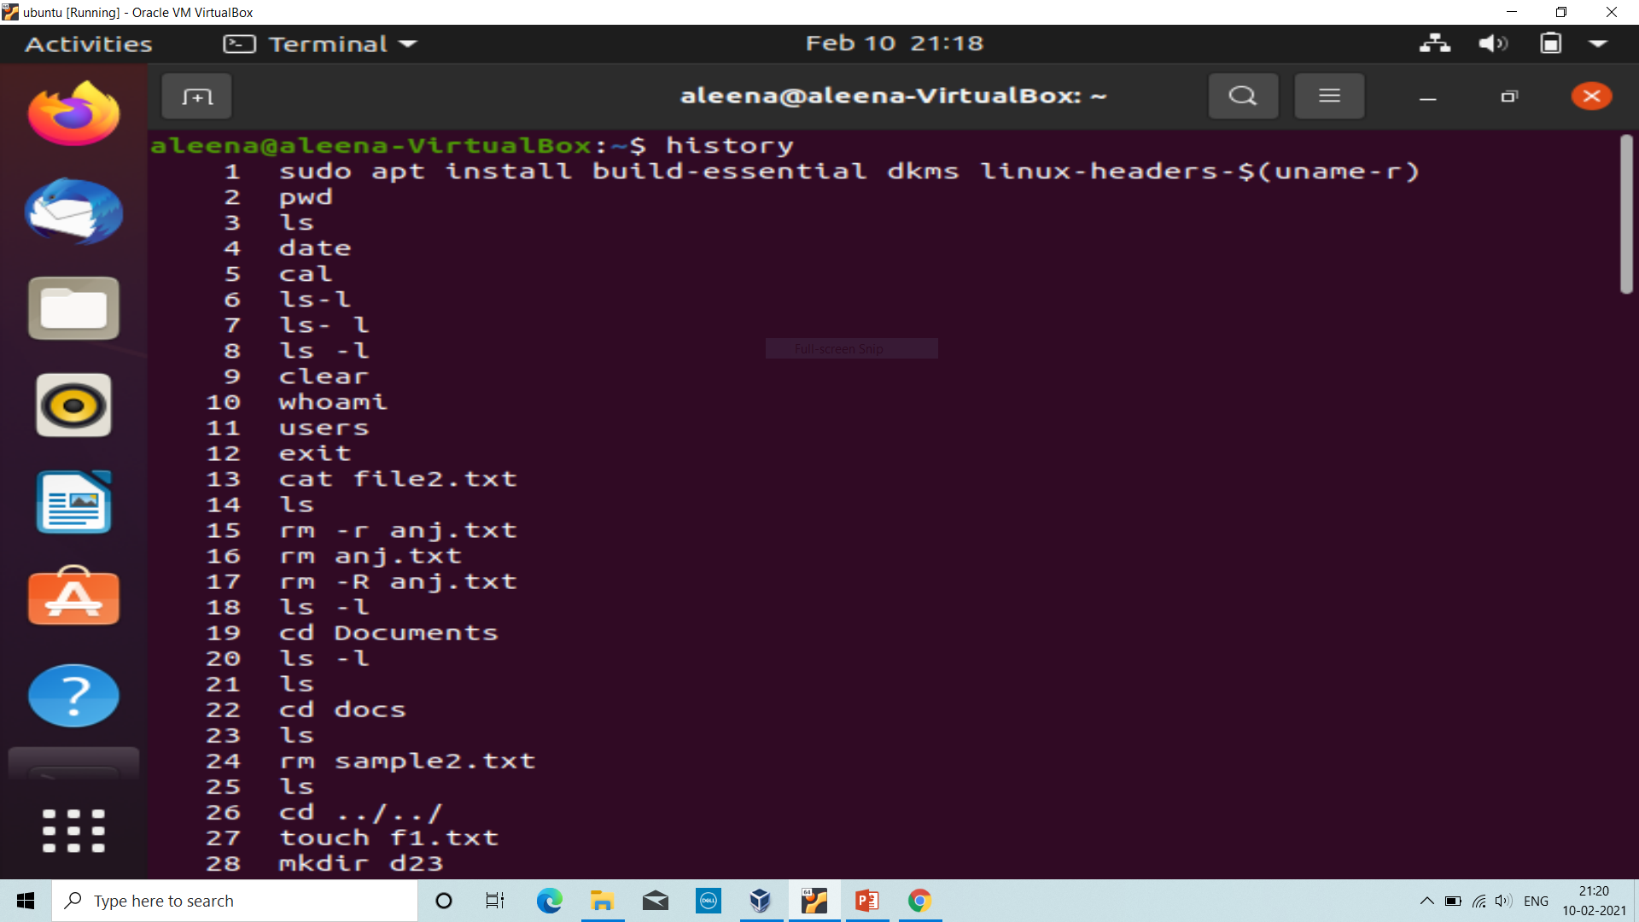
history: List out the history of commands used.
clear: Clear screen
exit: Exit the terminal.

Slide 14
THANK YOU

